Slide 1
Neural Language Models
CS 263: Natural Language Processing
Nanyun (Violet) Peng
Course website: https://vnpeng.net/cs263_sp24.html
syllabus,
announcements,
slides,
homework
1

Slide 2
Important Announcements
Quick recap and Q&A about assignment 1
Quick recap and Q&A about the course project

Slide 3
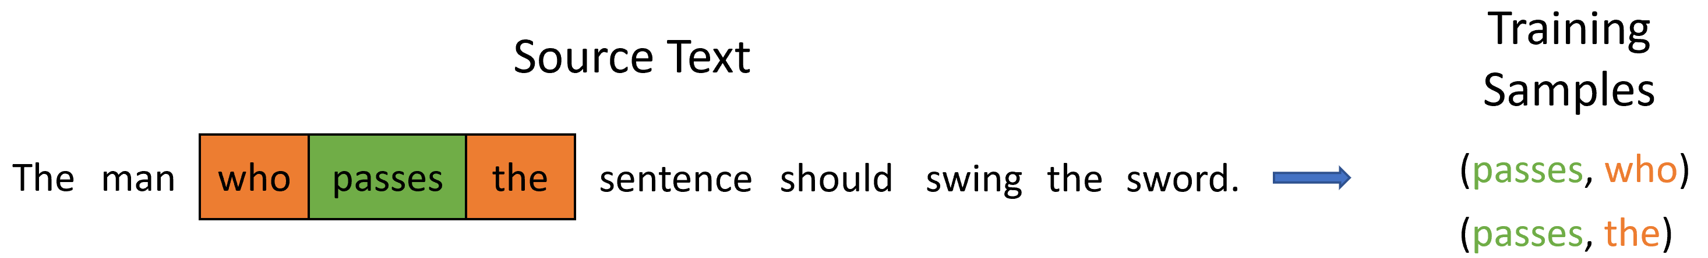
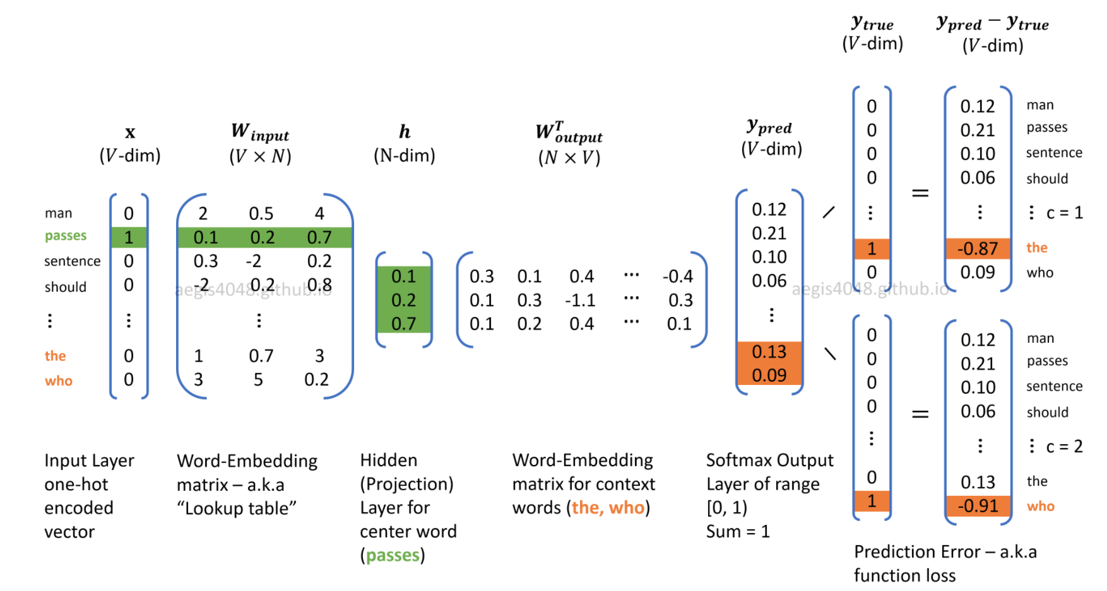
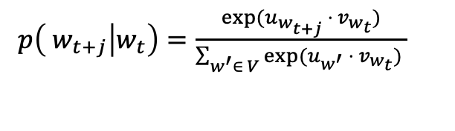
Quick recap of W2V skip-gram
Model parameters
Model parameters
-
$p\left( w_{t+j} | w_{t}\right)=\frac{exp⁡(u_{w_{t+j}} ⋅ v_{w_{t}})}{\sum_{w^{′}∈ V}{exp⁡(u_{w^{′}} ⋅ v_{w_{t}})} }$
Figure credit: https://aegis4048.github.io/demystifying_neural_network_in_skip_gram_language_modeling

Slide 4
Outline
Introduction, intuition, and applications of of language modeling
From ngram LMs to feedforward LMs
Neural network basics
Feedforward language model

Slide 5
What is a language model?
I ate
?
Example credit: Mark Dredze
Notes:
What is driving this technology
What do you need to know to answer this?

Slide 6
What is a language model?
For dinner I ate
?
Example credit: Mark Dredze
Notes:
What do you need to know to answer this?

Slide 7
What is a language model?
As a vegetarian for dinner I ate
?
Example credit: Mark Dredze
Notes:
What do you need to know to answer this?

Slide 8
What is a language model?
Despite being a vegetarian for dinner I ate
?
Example credit: Mark Dredze
Notes:
What do you need to know to answer this?

Slide 9
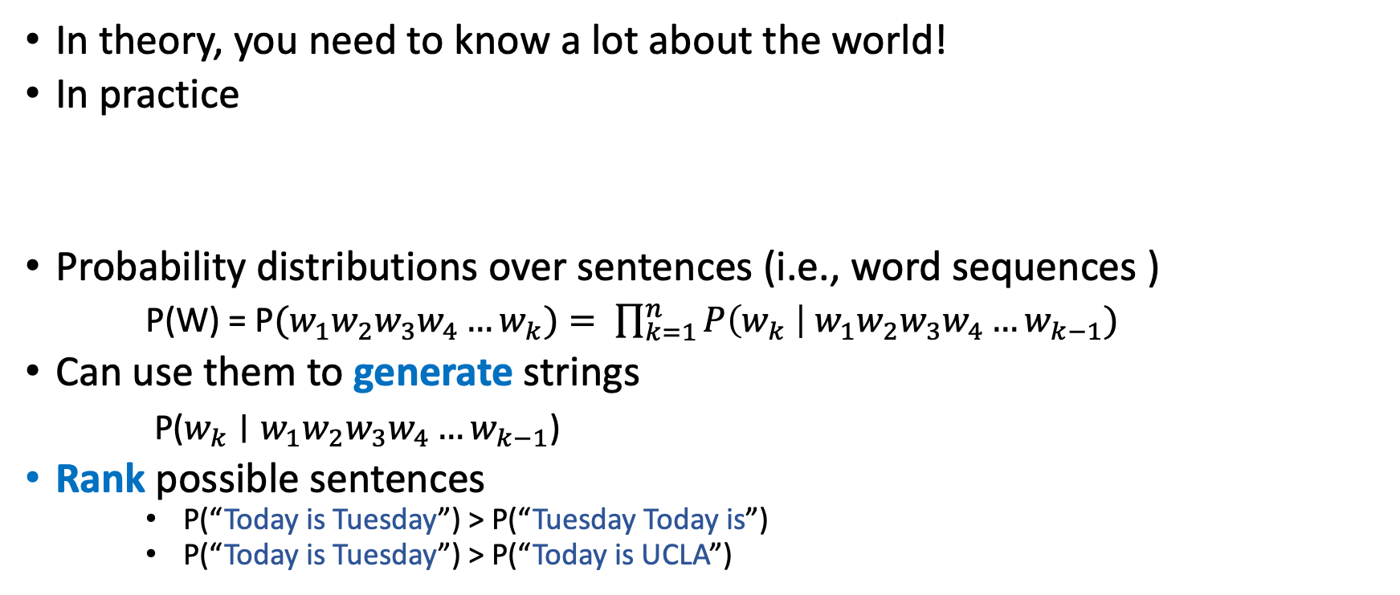
What is a language model?
In theory, you need to know a lot about the world!
In practice
Probability distributions over sentences (i.e., word sequences )
P(W) = P$(w_{1}w_{2}w_{3}w_{4}…w_{k})= \prod_{k=1}^{n}{P\left(w_{k} \right| {w_{1}w}_{2}w_{3}w_{4}…w_{k−1})}$
Can use them to generate strings
P($w_{k}∣{w_{1}w}_{2}w_{3}w_{4}…w_{k−1}$)
Rank possible sentences
P(“Today is Tuesday”) > P(“Tuesday Today is”)
P(“Today is Tuesday”) > P(“Today is UCLA”)
S = For dinner I ate pizza
Previous words (context)
Word being predicted

Slide 10

Language model applications
Context-sensitive spelling correction

Slide 11
Context-sensitive spelling correction
Which is most probable?
… I think they’re okay …
… I think there okay …
… I think their okay …
Which is most probable?
… by the way, are they’re likely to …
… by the way, are there likely to …
… by the way, are their likely to …

Slide 12
Machine Translation
 | good English? (n-gram) | good match to French?
Violet appeared in TV. |  | ✓
Appeared on Violet TV.
In Violet appeared TV. |  | ✓
Violet is happy today. | ✓
Violet appeared on TV. | ✓ | ✓
TV appeared on Violet. | ✓
TV in Violet appeared.
Violet was not happy. | ✓

Slide 13

Autocompletion
Notes:
veloci'raptor

Slide 14

Smart Reply

Slide 15
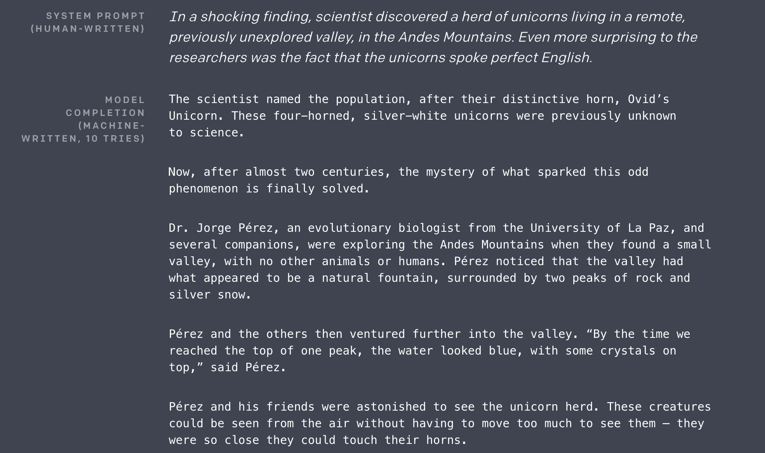
Language generation for everything
https://openai.com/research/better-language-models
GPT2 released in 2019
GPT3 released in 2020
GPT3.5 released in 2022
ChatGPT released in
Nov. 2022
GPT4 released in 2023
Notes:
When I found out my grandma was in the hospital I felt a particular color. When someone cut me off in the traffic I felt a different color. What is the most likely color I would see if I combined these two colors?
Michael is at that very famous museum in France looking at its most famous painting. However, the artist who made this painting just makes Michael think of his favorite cartoon character from his childhood. What was the country of origin of the thing that the cartoon character usually holds in his hand?
Can you write a sonnet about natural language processing class?

Slide 16
Outline
Introduction, intuition, and applications of of language modeling
From ngram LMs to feedforward LMs
Neural network basics
Feedforward language model

Slide 17
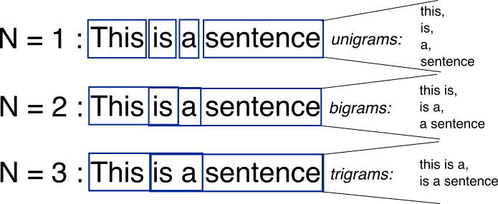
N-grams
N-grams: a contiguous sequence of n tokens from a given piece of text
N-gram LMs models p(x_{{t:t+n}}), or p(x_{t+n}|x_{{t:t+n-1}}).

Slide 18
Practical details (I)
Trigram model assumes two-word history
But consider these sentences:
What's wrong?
a sentence shouldn't end with 'yellow'
a sentence shouldn't begin with 'feeds'
Does the model capture these problems?
w₁ | w₂ | w₃ | w₄
he | saw | the | yellow
feeds | the | cats | daily

Slide 19
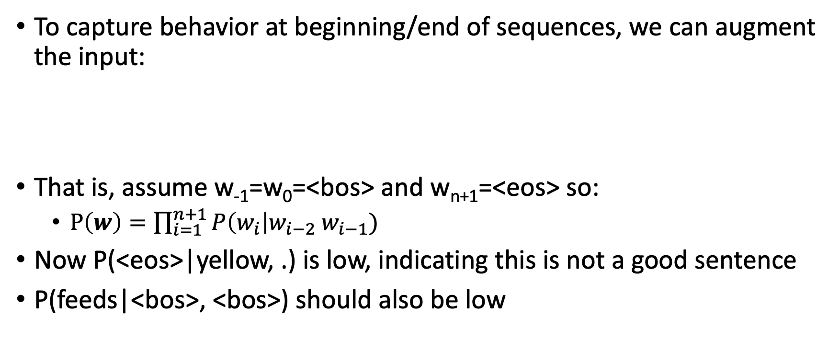
Beginning / end of sequence
To capture behavior at beginning/end of sequences, we can augment the input:
That is, assume w₋₁=w₀=<bos> and w_{n+1}=<eos> so:
$P\left(w\right)=\prod_{i=1}^{n+1}{P\left(w_{i}\right|w_{i−2} w_{i−1})}$
Now P(<eos>|yellow, .) is low, indicating this is not a good sentence
P(feeds|<bos>, <bos>) should also be low
w₋₁ | w₀ | w₁ | w₂ | w₃ | w₄ | w₆
<bos> | <bos> | he | saw | the | yellow | <eos>
<bos> | <bos> | feeds | the | cats | daily | <eos>

Slide 20
Beginning / end of sequence
Alternatively, we could model all sentences as one (very long) sequence, including punctuation
two cats live in sam 's barn . sam feeds the cats daily . yesterday , he saw the yellow cat catch a mouse . [...]
This is the standard practice for LLM training.
Now, trigram probabilities like P(. | cats daily) and P(, | . yesterday) tell us about behavior at sentence edges
Here, all tokens are lowercased. What are the pros/cons of not doing that?

Slide 21
Practical details (II)
Word probabilities are typically very small.
Multiplying lots of small probabilities quickly gets so tiny we can't represent the numbers accurately.
So in practice, we typically use log probabilities
Since probabilities range from 0 to 1, log probs range from -∞ to 0
Instead of multiplying probabilities, we add log probs
Often, negative log probs are used instead; these are often called "costs"; lower cost = higher prob

Slide 22
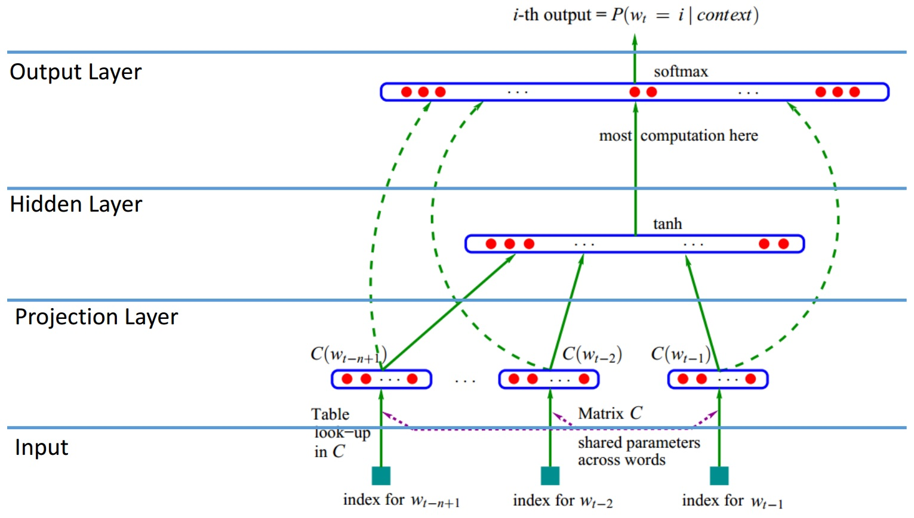

Feedforward neural language model
Model $p(x_{t+n}|x_{t:t+n−1})$ with a neural network.
Notes:
A brief introduction

Slide 23
Why?
Potentially generalize to unseen contexts
Example: “the shoes are blue”
This does not occurs in training corpus but
“the glasses are red” does.
If the word representations of “red” and “blue” are similar, and “shoes” and “glasses” are somewhat similar, then the model can generalize.
Why are “red” and “blue” similar?
Because we saw “red skirt”, “blue skirt”, “red pen”, ”blue pen”, etc.
Their word embeddings are similar.

Slide 24
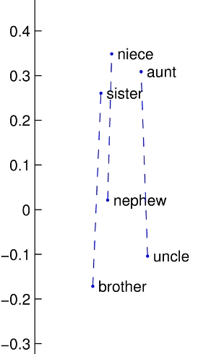
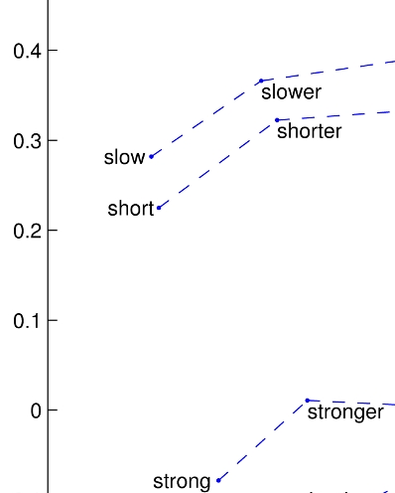
How to model word similarities?
Gender: man -- woman
Syntax: base -- comparative
Word Embeddings!
Picture credit: Pennington et. al. EMNLP 2014

Slide 25
Outline
Introduction, intuition, and applications of of language modeling
From ngram LMs to feedforward LMs
Neural network basics
Feedforward language model

Slide 26
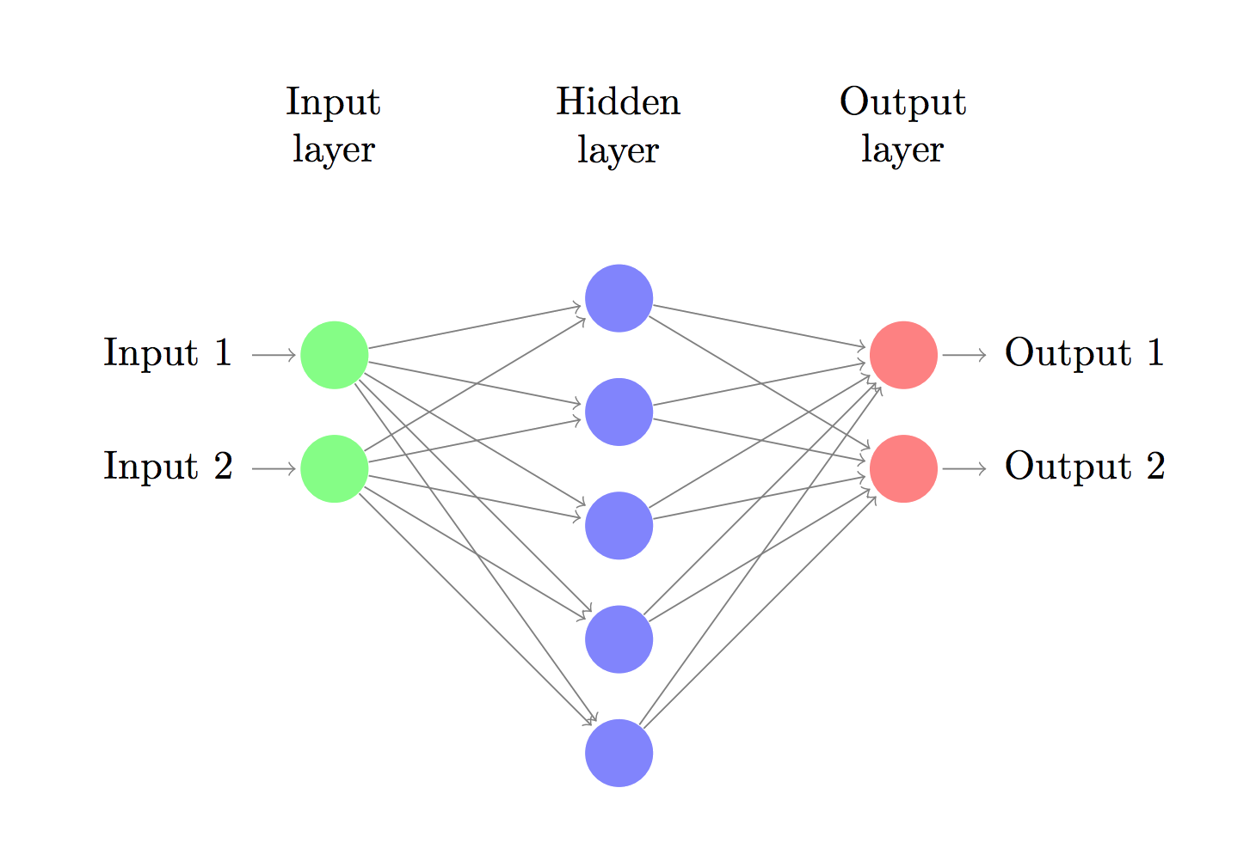
Neural Networks Recap
Let’s consider a 3-layer neural network

Slide 27






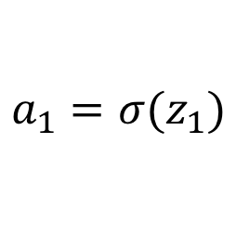




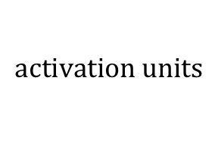
How NN Makes Predictions
forward pass: take input, and produce output
Just a bunch of linear transformation and applying the activation functions to introduce non-linearity
$$z_{1}=W_{1}x+b_{1}$$
$$W_{1}, b_{1}$$
$$W_{2}, b_{2}$$
$$a_{1}=σ⁡(z_{1})$$
$$z_{2}=W_{2}a_{1}+b_{2}$$
$$input, x$$
$$output, \hat{y}$$
$$a_{2}= \hat{y}=softmax(z_{2})$$
$$z_{1}$$
$$a_{1}$$
$$z_{2}$$
$$activation units$$
Notes:
Sigmoid, tanh, relu

Slide 28
Learning the Parameters
Find parameters that minimize the loss (or maximizes the likelihood) of the training data L(x, y).
How to minimize the loss function?
Gradient Descent – batch or mini batch or stochastic!
We need gradients of the loss function with respect to the parameters – what are our parameters?
How to compute the gradients of the parameters?
Backpropagation algorithm!

Slide 29
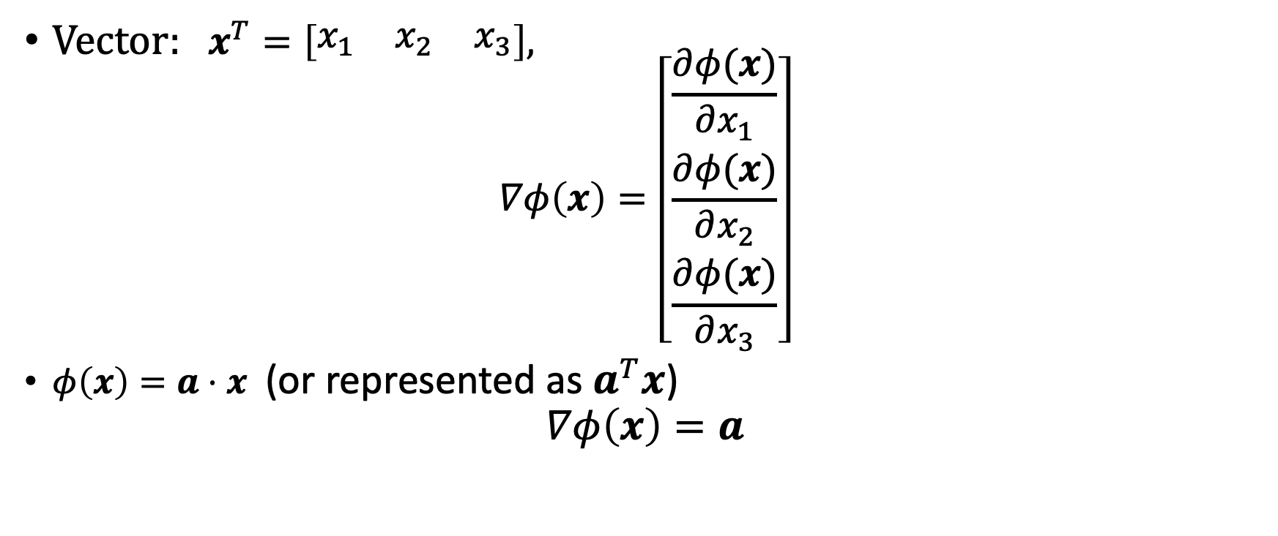
Recap: Calculus
Vector: $x^{T}=\left[\begin{matrix}x_{1} & x_{2} & x_{3}\end{matrix}\right],$
$$∇φ\left(x\right)=\left[\begin{matrix}\frac{∂φ(x)}{∂x_{1}} \\ \frac{∂φ(x)}{∂x_{2}} \\ \frac{∂φ(x)}{∂x_{3}}\end{matrix}\right]$$
$φ\left(x\right)=a⋅x$ (or represented as $a^{T}x$) $∇φ\left(x\right)=a$
Notes:
Multivariant calculus

Slide 30
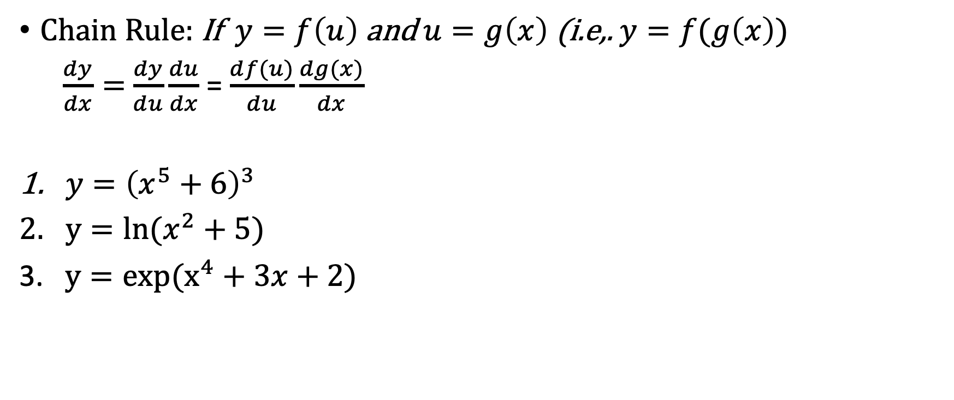
Recap: Chain Rule
Chain Rule: If $y=f\left(u\right)$ and $u=g\left(x\right)$ (i.e,. $y=f(g\left(x\right))$
$\frac{dy}{dx}=$ $\frac{dy}{du}\frac{du}{dx}$ = $\frac{df(u)}{du}\frac{dg(x)}{dx}$
$y={\left(x^{5}+6\right)}^{3}$
$y=ln⁡(x^{2}+5)$
3. $y=exp(x^{4}+3x+2)$
calculus facts:
∂/∂x mx = mdx;
∂/∂x log(x) = 1/x dx (log here = natural log, i.e. log_{e}, i.e. ln)
∂/∂x exp(x) = exp(x)dx
Notes:
Ask students to do the practice.
3(x^5 + 6)^2 \dot 5x^4
\frac{2x}{x^2+5}
(4x^3+3)exp(x^4+3x+2)

Slide 31
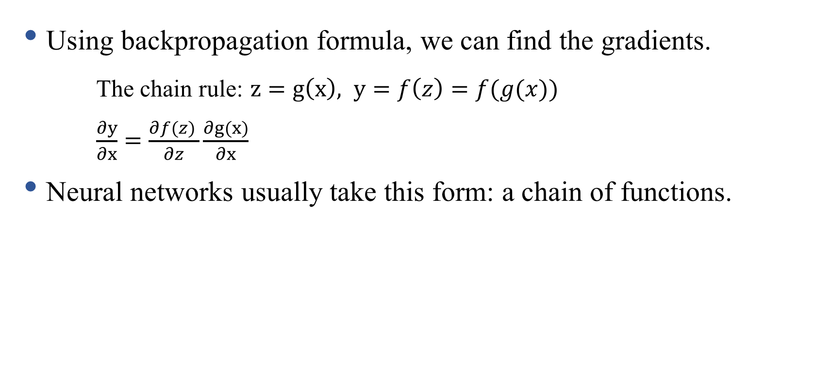
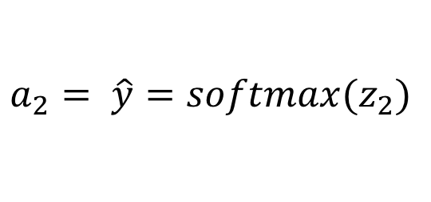
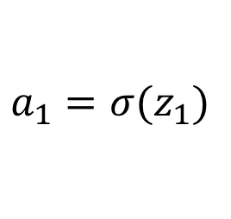

Backpropagation
Using backpropagation formula, we can find the gradients.
The chain rule: $z=g\left(x\right), y=f\left(z\right)=f(g(x))$
$\frac{∂y}{∂x}=\frac{∂f(z) }{∂z}\frac{∂g(x)}{∂x}$
Neural networks usually take this form: a chain of functions.
$$z_{1}=W_{1}x+b_{1}$$
$$a_{1}=σ⁡(z_{1})$$
$$z_{2}=W_{2}a_{1}+b_{2}$$
$$a_{2}= \hat{y}=softmax(z_{2})$$

Slide 32

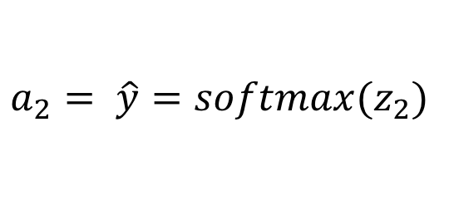

Recipe for Backpropagation
Identify intermediate functions
Compute local gradients
Combine with upstream error signal to get full gradient
$$z_{1}=W_{1}x+b_{1}$$
$$W_{1}, b_{1}$$
$$W_{2}, b_{2}$$
$$a_{1}=σ⁡(z_{1})$$
$$z_{2}=W_{2}a_{1}+b_{2}$$
$$input, x$$
$$output, \hat{y}$$
$$a_{2}= \hat{y}=softmax(z_{2})$$
$$z_{1}$$
$$a_{1}$$
$$activation units$$

Slide 33
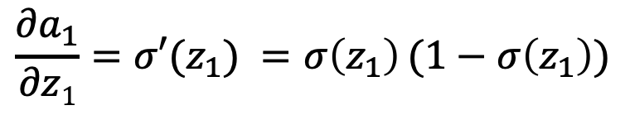

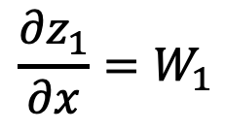
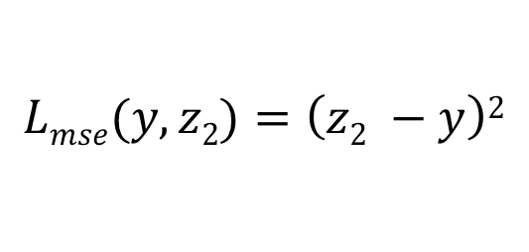
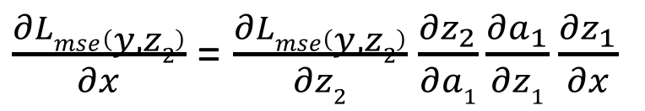

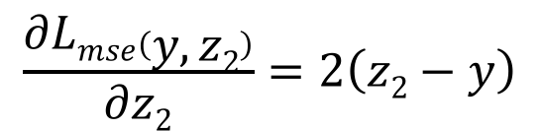
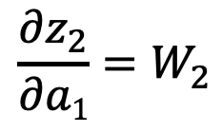
Intermediate Variables (forward propagation)
Intermediate Gradients (backward propagation)
$$z_{1}=W_{1}x+b_{1}$$
$$\frac{{∂z}_{1}}{∂x}=W_{1}$$
$$\frac{{∂a}_{1}}{∂z1}=σ′(z_{1}) =σ\left(z_{1}\right)(1−σ\left(z_{1}\right))$$
$$a_{1}=σ⁡(z_{1})$$
$$\frac{{∂z}_{2}}{∂a1}=W_{2}$$
$$z_{2}=W_{2}a_{1}+b_{2}$$
$$Lmse(y,z2)=\left(z2 −y\right)2$$
$$\frac{∂Lmse\left(y, z2\right)}{∂z2}=2\left(z2−y\right)$$
$\frac{∂Lmse\left(y, z2\right)}{∂x}$ = $\frac{∂Lmse\left(y, z2\right)}{∂z2}$ $\frac{{∂z}_{2}}{∂a1}\frac{{∂a}_{1}}{∂z1}\frac{{∂z}_{1}}{∂x}$

Slide 34

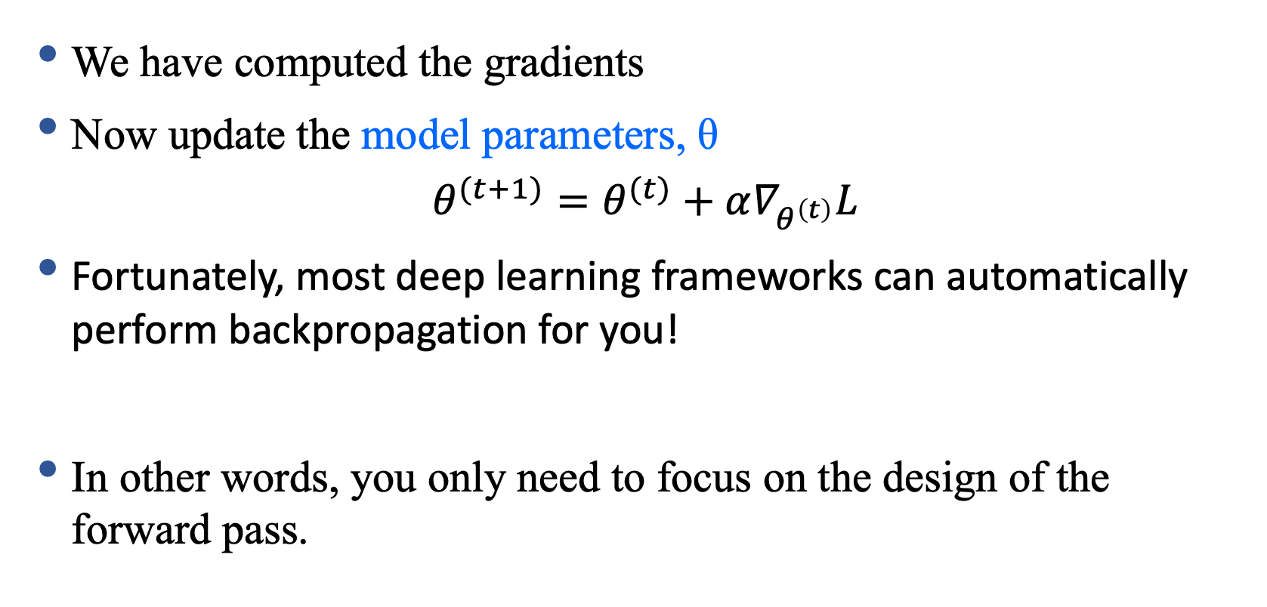
Update the Parameters
We have computed the gradients
Now update the model parameters, θ
$$θ^{(t+1)}=θ^{(t)}+α∇_{θ^{\left(t\right)}}L$$
Fortunately, most deep learning frameworks can automatically perform backpropagation for you!
In other words, you only need to focus on the design of the forward pass.

Slide 35
Outline
Introduction, intuition, and applications of of language modeling
From ngram LMs to feedforward LMs
Neural network basics
Feedforward language model

Slide 36

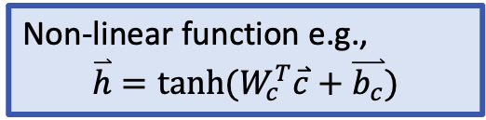
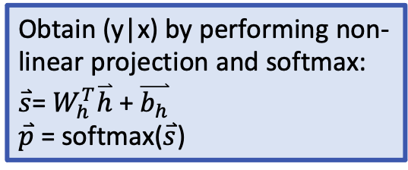
Feedforward Neural language model
Model $p(x_{t+n}|x_{t:t+n−1})$ with a neural network.
Obtain (y|x) by performing non-linear projection and softmax:
$\overset{⃑}{s}$= $W_{h}^{T}\overset{⃑}{h}$ + $\overset{⃑}{b_{h}}$
$\overset{⃑}{p}$ = softmax($\overset{⃑}{s}$)
Y. Bengio et al., JMLR’03
Non-linear function e.g.,
$$\overset{⃑}{h}=tanh⁡(W_{c}^{T}\overset{⃑}{c}+\overset{⃑}{b_{c}})$$
Concatenate projected vectors to get multi-word contexts.
Word representations to project inputs into low-dimensional vectors

Slide 37
Recall word embeddings
Word tokens map to vectors in a low-dimensional space
Conditional word probabilities are produced by neural network models on vectors of word embeddings
Vector-space representation enables semantic/syntactic similarity between words/sentences
Use cosine similarity can measure word similarity
Find nearest neighbours: synonyms, antonyms
Algebra on words: {king} – {man} + {woman} = {queen}

Slide 38
Vector-space representation of words
One-hot representation of the prediction of target word w_{t} (we predict a vector of size V)
1
v
V
_{Ct-1}
Vector-space representation of any word v in the vocabulary using a vector of dimension D
_{Cv}
1
Vector-space representation of the t^{th} word’s history: e.g., concatenation of n-1 vectors of size D
_{Ct-2}
D
_{Ct-3}

Slide 39
Learning continuous space language models
Input:
N-gram word history (low-dimensional vector representation)
Output:
target word (1-hot vector representation)
Function that approximates the conditional word likelihood p(x_{t} | x_{1:t-1}):
Similar mechanism in skip-gram
Feed-forward neural network
Recurrent neural network
…

Slide 40
Learning continuous space language models
How do we learn the word representations for each word in the vocabulary?
How do we learn the model that predicts the next word or its representation ẑ_{t} given a word history?
Simultaneous learning of model and representation
What are the parameters of the model?

Slide 41
Objective function
likelihood:
Objective function to maximize:
Log-likelihood
In general, the objective function is defined as: score of the right answer – a normalization term

Slide 42
Learning neural language models
Maximize the log-likelihood (minimize the negative log-likelihood) of observed data, w.r.t. parameters θ of the neural language model
Parameters θ in a feedforward neural language model:
Word embedding matrix E (some variation: bias b_{v})
Neural network weights: W_{c}, b_{c} , W_{h}, b_{h},
Gradient descent with learning rate η:
In practice, current deep learning frameworks automatically perform backpropagation for you

Slide 43
Limitation of the Feedforward Neural Language Model
Sparsity – Solved
Word Similarity – Solved
Finite/fixed Context – Not solved yet
Next time:
RNN language models

